Slide 1
Profiling ARM-Instrumented Applications via RPT
Yoonki Song
Last Updated: 9/24/2009

Slide 2
Prerequisites
Part I

Slide 3
Prerequisites
Server Side
WebSphere Application Server (WSAS) v6.1 Setup
Refer to “PerfTest – Setup (WSAS).pptx”
Rational Performance Tester (RPT) Agent v8.0 Setup
Refer to “PerfTest –Setup (RPT agent).ppt”
Client Side
Rational Performance Tester (RPT) v8.0 Setup
Refer to “PerfTest – Setup (RPT).pptx”

Slide 4

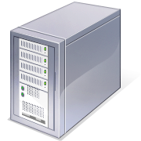

Environment for ARM Instrumentation
Client:
My desktop (Dynamic IP)
Java v1.5 (or lower)
Rational Performance Tester v8.0
with Agent (Data Collection Infrastructure v7.0)
Server:
eb2-2241-grd03.csc.ncsu.edu (152.14.90.72)
Java v1.5 (or lower)
WebSphere Application Server v6.1
Rational Performance Tester Agent
(Data Collection Infrastructure v7.0)

Slide 5

Sequence for Collecting Trace data with Instrumentation (RPT-ARM)
Client
Server
#/root/perftest/startARM.sh
Start Rational Agent Controller (RAC)
Note: RAC should be running prior to DCI
Start Data Collection Infrastructure (DCI)
Note: DCI should be running prior to WSAS
Start WebSphere Application Server (WSAS)
4. Start DCI
5. Start RPTv8.0
6. Start Recording and Launching Test/Schedule via RPT
Trace data (A)
Note: This task should be always done whenever the server/client reboots.
Notes:
3451 <- x
4513 <-

Slide 6
Instrumentation

Slide 7
Using the Java Profiler with JVM 1.4 (or lower)
Go to <profile root>/config/cells/<nodename>Cell/nodes/<nodename>/servers/server1
Edit the jvmEntries element in the server.xml Specifically, append –XrunpiAgent:server=enabled to the genericJvmArguments attribute value.
Restart WSAS

Slide 8
Instrumentation Steps
# /root/perftest/gotoARM.sh
Start WebSphere Application Server (WSAS)
Note: WSAS should be running before applications are instrumented.
Start Instrumentation
Restart the server
Note: This task should be done only once.

Slide 9
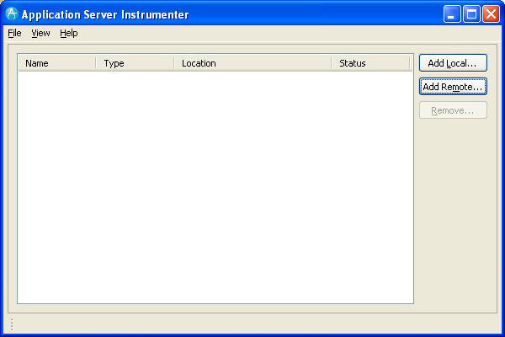
Application Server Instrumenter (ASI)

Slide 10
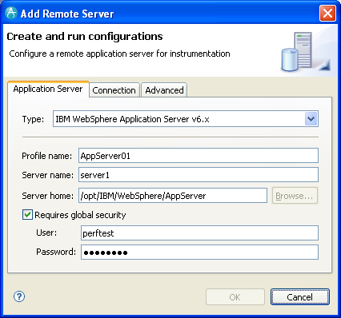
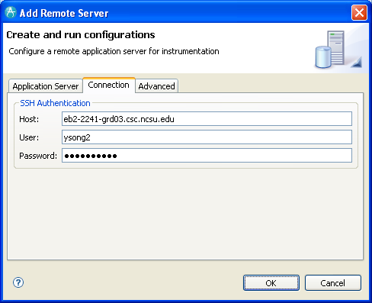
Application Server Instrumenter (ASI)

Slide 11
Application Server Instrumenter (ASI)
Application Server Tab
Type: IBM WebSphere Application Server v6.x
Profile name: AppSrv01
Server name: eb2-2241-grd03.csc.ncsu.edu
Server home: /opt/IBM/WebSphere/AppServer
User: perftest
Password: perftest
Connection Tab
Host: eb2-2241-grd03.csc.ncsu.edu or ldap.ncsu.edu (?)
User: ysong2
Password: <?>

Slide 12
Three Important Configuration Files
{WAS_PROFILE_HOME}/config/cells/{cell_name}/nodes/{node_name}/servers/{server_name}
/opt/IBM/WebSphere/AppServer/profiles/AppSrv01/config/cells/eb2-2241-grd03Node01Cell/nodes/eb2-2241-grd03Node01/servers/server1/server.xml
/opt/IBM/WebSphere/AppServer/profiles/AppSrv01/config/cells/eb2-2241-grd03Node01Cell/nodes/eb2-2241-grd03Node01/servers/server1/variables.xml
{WAS_PROFILE_HOME}/config/cells/{cell_name}
/opt/IBM/WebSphere/AppServer/profiles/AppSrv01/config/cells/eb2-2241-grd03Node01Cell/pmirm.xml

Slide 13
…
/opt/IBM/SDP/DCI/rpa_prod/tivoli_comp/app/instrument/6.103.0000/appServers/server1_101/config

Slide 14
Profile Configuration on RPT

Slide 15
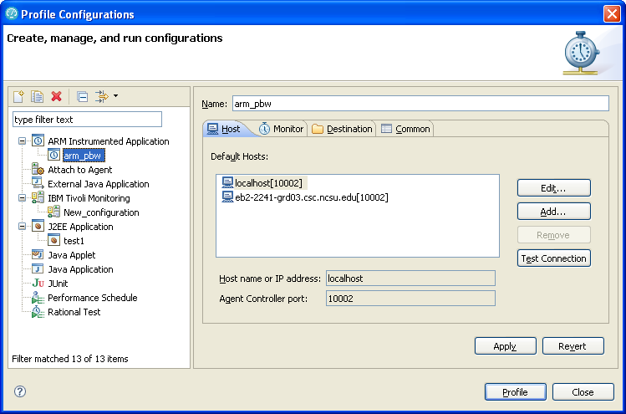
Profile Configurations

Slide 16
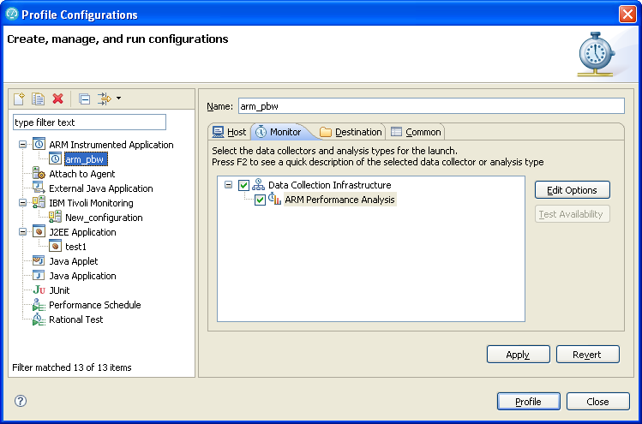
Profile Configurations (Cont’d)

Slide 17
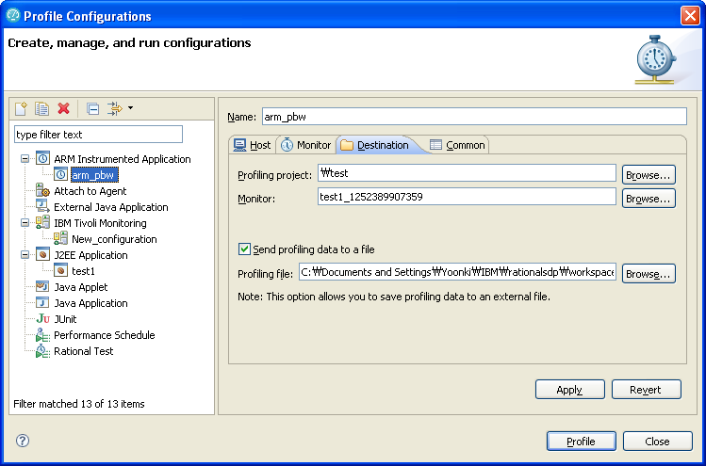
Profile Configurations (Cont’d)

Slide 18
Trouble Shooting

Slide 19
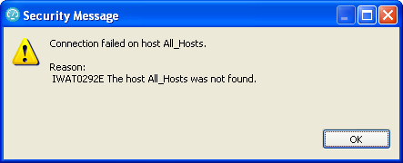
IWAT0292E
http://www.ibm.com/developerworks/forums/message.jspa?messageID=13938063

Slide 20
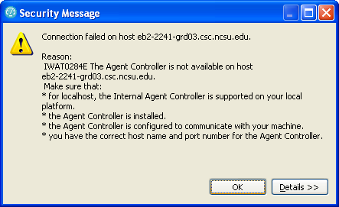
IWAT0284E
IWAT0284E

Slide 21
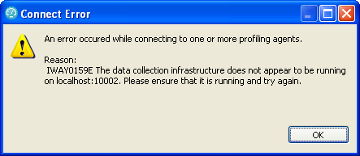
IWAY0159E

Slide 22
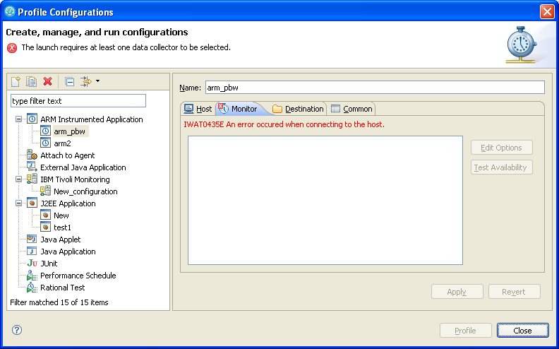
IWAT0435E

Slide 23
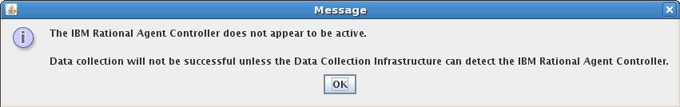
Trouble Shooting

Slide 24
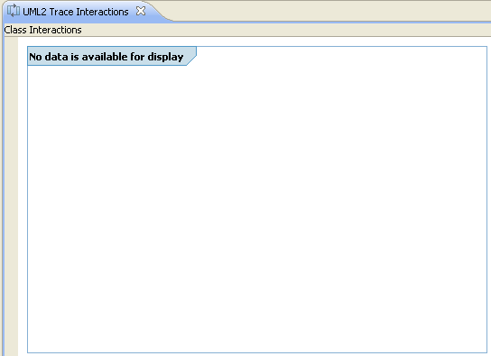
No data available for display
No data available for display

Slide 25
Hang “Connecting to the JVMPI agent”
My guess is that JVMTI (1.6) cannot deal with multi-threaded applications

Slide 26
References
Install WebSphere Application Server V6.0 for Linux on POWER (http://www.ibm.com/developerworks/systems/library/es-webapp/index.html)
WebSphere Application Server 6.1 Headless Install (http://bishop.camp.clarkson.edu/wiki/en/WebSphere_Application_Server_6.1_Headless_Install)

Slide 27
References
Using IBM Rational Performance Tester: Application Monitoring Part 1, Configuring your environment (http://www.ibm.com/developerworks/rational/library/07/0515_patel/index.html)
Using IBM Rational Performance Tester: Application Monitoring Part 2, Enabling real-time monitoring (http://www.ibm.com/developerworks/rational/library/07/0515_patel2/index.html)
Using IBM Rational Performance Tester: Application monitoring, Part 3: Importing data from IBM Tivoli database products (http://www.ibm.com/developerworks/rational/library/07/0605_patel/index.html)

Slide 28
Experiments

Slide 29
Best Practices
Reboot the client (My desktop)
Start RPT
Check whether ACWinService.exe is running
Start DCI
ACWinService
RPT
DCI

Slide 30
File extensions
Extension | Description
executiondlr
Trcadlr
Trcaxmi | Trace Agent
Trciovxmi
Trcmxmi | Trace Monitor
Trcnxmi | Trace Node
Trcpxmi | Trace Process
trcxml

Slide 32
TestProj4
One performance test (test4)
No test results
D:\Dev\WorkspaceRPT\TestProj4
Tests\test4.rec
Tests\test4.recmodel
Tests\test4.testsuite

Slide 33
TestProj4
No “Response time breakdown” option
test4.executiondlr
test4_1254968674765.trcmxmi
test4_1254968674765_All_Hosts.trcnxmi
test4_1254968674765_All_Hosts_XMLStatisticalDataProcessor.trcadlr
test4_1254968674765_All_Hosts_XMLStatisticalDataProcessor.trcpxmi
test4_1254968674765_turing.trcnxmi
test4_1254968674765_turing_XMLStatisticalDataProcessor.trcadlr
test4_1254968674765_turing_XMLStatisticalDataProcessor.trcpxmi

Slide 34
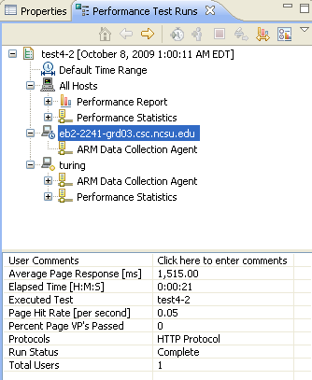
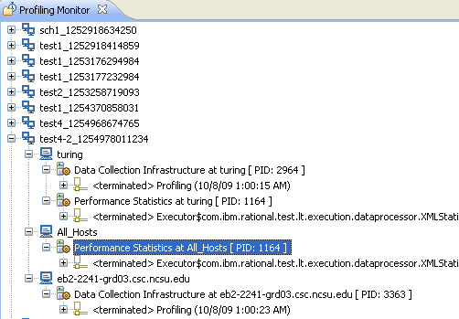
TestProj4-2

Slide 35
TestProj4-2
One performance test (test4-2)
One test results with test4-2 (automated)
D:\Dev\WorkspaceRPT\TestProj4-2
Tests\test4-2.rec
Tests\test4-2.recmodel
Tests\test4-2.testsuite

Slide 36
TestProj4-2
“Response time breakdown” option
test4-2.executiondlr
test4-2_1254978011234.trcmxmi
test4-2_1254978011234_All_Hosts.trcnxmi
test4-2_1254978011234_All_Hosts_XMLStatisticalDataProcessor.trcadlr
test4-2_1254978011234_All_Hosts_XMLStatisticalDataProcessor.trcpxmi
test4-2_1254978011234_eb2-2241-grd03.csc.ncsu.edu.trcnxmi
test4-2_1254978011234_eb2-2241-grd03.csc.ncsu.edu_3363_ThuOct08010021EDT2009.trcpxmi
test4-2_1254978011234_eb2-2241-grd03.csc.ncsu.edu_3363_Thursday,October8,200910021AMET_1254978021265_ARM Data Collection Agent.trcaxmi
test4-2_1254978011234_eb2-2241-grd03.csc.ncsu.edu_3363_Thursday,October8,200910021AMET_1254978021265_ARM Data Collection Agent.trciovxmi
test4-2_1254978011234_turing.trcnxmi
test4-2_1254978011234_turing_2964_ThuOct08010013EDT2009.trcpxmi
test4-2_1254978011234_turing_2964_Thursday,October8,200910013AMET_1254978013828_ARM Data Collection Agent.trcaxmi
test4-2_1254978011234_turing_2964_Thursday,October8,200910013AMET_1254978013828_ARM Data Collection Agent.trciovxmi
test4-2_1254978011234_turing_XMLStatisticalDataProcessor.trcadlr
test4-2_1254978011234_turing_XMLStatisticalDataProcessor.trcpxmi
PID of DCI

Slide 37
TestProj4-3
One performance test (test4-3)
One test results with test4-3 (manual)
D:\Dev\WorkspaceRPT\TestProj4-3
Tests\test4-3.rec
Tests\test4-3.recmodel
Tests\test4-3.testsuite

Slide 38
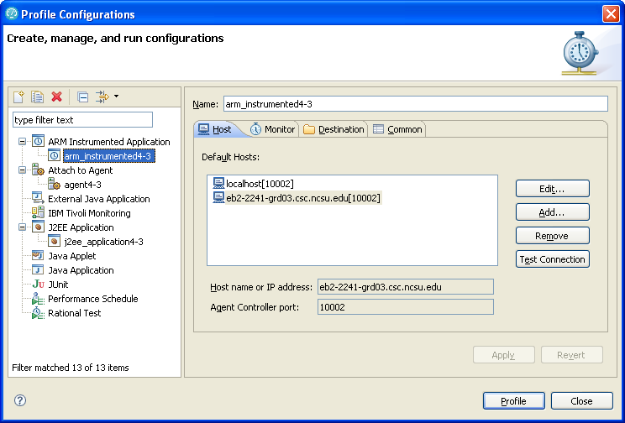
TestProj4-3
Profile via ARM Instrumented Application
Preferred!
Not Preferred!
Preferred!

Slide 39
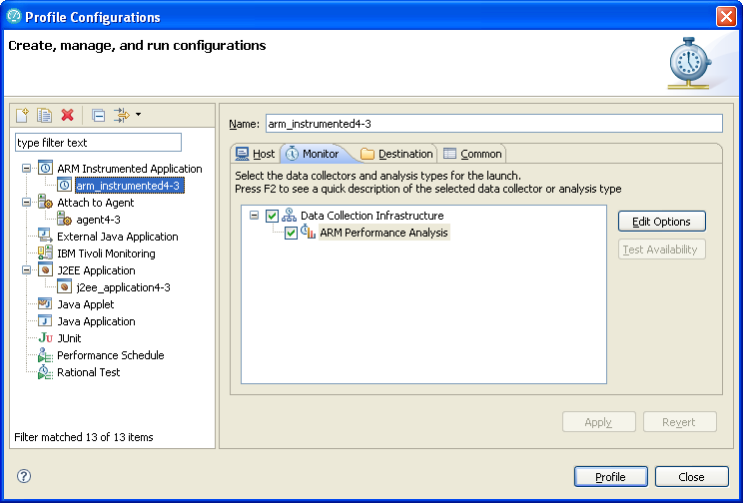
TestProj4-3
Profile via ARM Instrumented Application

Slide 40
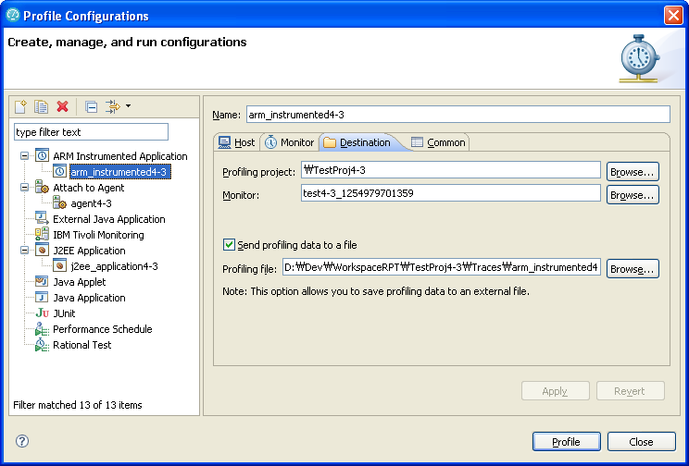
TestProj4-3
Profile via ARM Instrumented Application

Slide 41
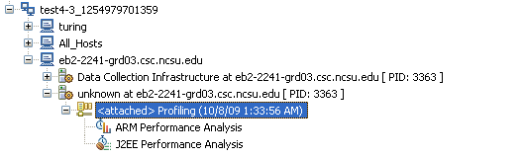

Slide 42
TestProj4-3
“Response time breakdown” option
test4-3.executiondlr
test4-3_1254979701359.trcmxmi
test4-3_1254979701359_All_Hosts.trcnxmi
test4-3_1254979701359_All_Hosts_XMLStatisticalDataProcessor.trcadlr
test4-3_1254979701359_All_Hosts_XMLStatisticalDataProcessor.trcpxmi
test4-3_1254979701359_eb2-2241-grd03.csc.ncsu.edu.trcnxmi
test4-3_1254979701359_eb2-2241-grd03.csc.ncsu.edu_3363_ThuOct08010021EDT2009.trcpxmi
test4-3_1254979701359_eb2-2241-grd03.csc.ncsu.edu_3363_Thursday,October8,200910021AMET_1254978021265_ARM Data Collection Agent.trcaxmi
test4-3_1254979701359_eb2-2241-grd03.csc.ncsu.edu_3363_Thursday,October8,200910021AMET_1254978021265_ARM Data Collection Agent.trciovxmi
test4-3_1254979701359_turing.trcnxmi
test4-3_1254979701359_turing_2964_ThuOct08010013EDT2009.trcpxmi
test4-3_1254979701359_turing_2964_Thursday,October8,200910013AMET_1254978013828_ARM Data Collection Agent.trcaxmi
test4-3_1254979701359_turing_2964_Thursday,October8,200910013AMET_1254978013828_ARM Data Collection Agent.trciovxmi
test4-3_1254979701359_turing_XMLStatisticalDataProcessor.trcadlr
test4-3_1254979701359_turing_XMLStatisticalDataProcessor.trcpxmi

